Slide 1

AIML MODULE-1

Slide 2
AGENT VS RATIONAL AGENT
A general term for any system that can perceive its environment and act upon it .
Examples include robots, software programs, or even a thermostat.
An agent's actions are determined by its internal rules or program.
It doesn't necessarily make the "best" decisions, it just acts based on its programming.
An agent that chooses actions that are expected to maximize its performance measure, given the information it has.
It uses reasoning, prediction, and sometimes learning to make optimal decisions.
Rationality is about making the best possible decision given the circumstances and the information available.
It doesn't guarantee success but aims to maximize the chances of success based on available knowledge

Slide 3
AGENT VS RATIONAL AGENT
Aspect | Agent | Rational Agent
Definition | Any autonomous entity that perceives its environment and takes actions to achieve a specific goal. | An agent that always chooses actions to maximize its expected performance or achieve the best possible outcome, based on its knowledge and the environment.
Behavior | May act based on fixed rules, simple heuristics, or pre-programmed instructions (not always optimal). | Always tries to do the “right thing” by selecting actions that are most likely to fulfill its goals efficiently, given what it knows.
Decision Process | Does not necessarily optimize; may follow static or reactive strategies. | Makes decisions using reasoning, optimization, and sometimes prediction or learning to improve outcomes.
Outcome Focus | Can be reactive, non-optimized, or limited in adaptability. | Seeks to maximize a performance measure (utility, reward, efficiency) for each situation.
Examples | - ATM: Dispenses cash based on inputs, regardless of context. | - Autonomous robot: Adjusts cleaning strategy for efficiency. - Self-driving car: Chooses routes to minimize time/risk.

Slide 4
PEAS:
PEAS is a framework used to describe the characteristics of an intelligent agent's task environment.
It stands for Performance measure, Environment, Actuators, and Sensors.
PEAS helps in designing and analyzing AI systems by outlining how an agent interacts with its surroundings to achieve its goals.
Performance measure:
Defines how success is evaluated for the agent.
Environment:
Refers to the external context in which the agent operates.

Slide 5
PEAS:
Actuators :
By which the agent interacts with its environment to perform actions.
Sensors:
Provide the agent with information about its environment.

Slide 6
Example-1:
Self-driving car:
Performance Measure: Safety, efficiency, and comfort of the ride.
Environment: Roads, traffic, pedestrians, weather conditions.
Actuators: Steering, braking, acceleration, and signaling systems.
Sensors: Cameras, LIDAR, radar, GPS, and ultrasonic sensors.

Slide 7
Example-2:
Chatbot:
Performance Measure: Helpful and accurate responses.
Environment: Messaging platform, internet, website.
Actuators: Mechanisms for sending and displaying messages.
Sensors: Natural language processing (NLP) algorithms. .

Slide 8
SEARCH SPACE
SEARCH TREE
SOLUTION
OPTIMAL SOLUTION

Slide 9
SEARCH SPACE:
All possible solutions.
SEARCH TREE:
Tree representation of a search problem.
SOLUTION:
Action sequence leads from start node to goal node.
OPTIMAL SOLUTION:
Lowest cost among all solutions.

Slide 10
Searching
Uninformed search
Informed search
Uninformed search:
No extra information on each node.
It often slower and less efficient.
Ex: BFS, DFS, DLS, UCS
Informed search:
It has extra information on each node.
Usually faster and more effective.
Ex: Best First Search, A* search.

Slide 11
Applications
Path finding
Puzzle solving
Network routing
AI in video games

Slide 12
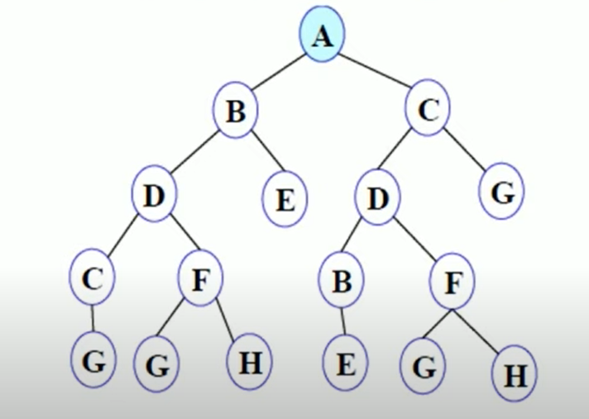
BFS:

Slide 13
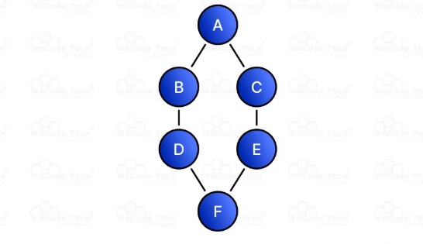
BFS:

Slide 14
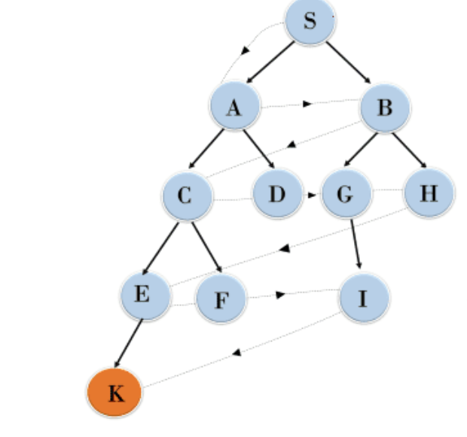
BFS:

Slide 15
1. What is Intelligence
Reasoning, Problem solving and Decision making
2. What is AI
Man-made thinking power
3. Types of AI based on capabilities
Narrow AI (where AI is less than Human intelligence)
General AI (where AI is equal Human intelligence)
Super AI (where AI is more than Human intelligence)
4. Types of AI based on functionalities
Reactive Machine
Limited memory
Theory of mind
Self-awareness

Slide 16
5. Father of AI
John Maccarthy
6. What is Alan Turing theory
Can a machine able to thinks like a human?
7.Problems solved by AI
Image classification
Text classification
Object detection, etc.

Slide 17
8. Examples of AI
Voice Assistants
Chatbots, Recommendation Systems
Seach engines
Facial recognition
Navigation and maps
Social media
Fraud detection

Slide 18
9. What are the examples of Agent
ATM, Vaccum Cleaner
10. What are the examples of Rational Agent
Self driving cars

